Slide 1
WELCOME!
European Citizens’ Initiative Forum Webinar:
Collecting Signatures Online – What you need to know about the Central Online Collection System with testimonials from successful ECIs!
Host: Vasiliki Mustakis
Participatory Democracy Coordinator, European Citizen Action Service (ECAS)
14 March 2023

Slide 2
Today’s Agenda
Introduction (10 minutes)
Brief overview of Central Online Collection System and its features by IT Project Officer Jerôme Stefanini
Presentation of experience using the Central Online Collection System by ECI Organiser Nils Kluger
Q&A with audience
Closing remarks

Slide 3
Interaction and Q&A
Interface: Please turn off your video and mute yourself during the presentations.
Language: English.
How to interact and ask questions: You can use the chat to ask questions. They will be noted and picked up by the moderator during the respective Q&A session.
The Webinar will be recorded and uploaded on the European Citizens’ Initiative Forum

Slide 4
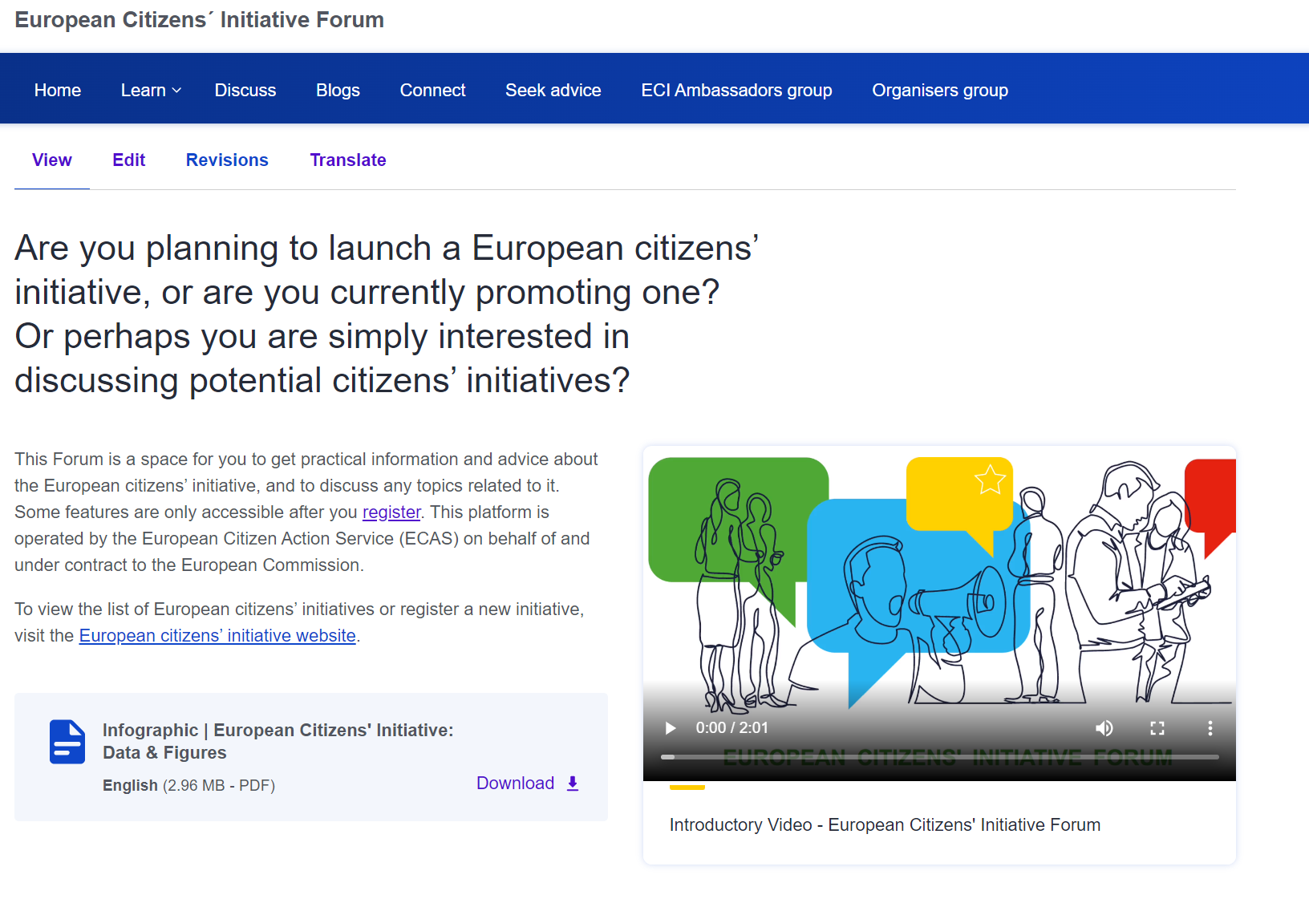
The European Citizens’ Initiative Forum
  A great tool for organising your initiative
  Learn Section: Webinars, Guidance Notes, Learning Material
  Blogs
  Discuss
  Seek Advice: if you need campaigning or fundraising advice during your campaign

Slide 5
What is the European Citizens’ Initiative?
Article 11(4) of the Treaty on the European Union:
Not less than one million citizens who are nationals of a significant number of Member States may take the initiative of inviting the European Commission, within the framework of its powers, to submit any appropriate proposal on matters where citizens consider that a legal act of the Union is required for the purpose of implementing the Treaties.
THE FIRST SUPRANATIONAL INSTRUMENT OF PARTICIPATORY DEMOCRACY

Slide 6
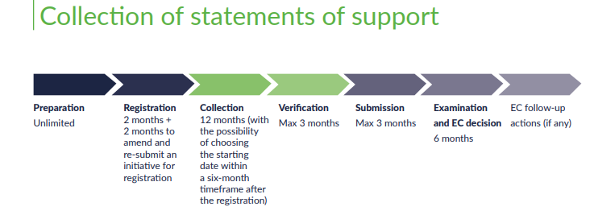
Campaign preparation: It is pivotal to start organising your campaign during this time
Notes:
It is pivotal to start organising your campaign during this time between registration and the start of your collection period.

Slide 7
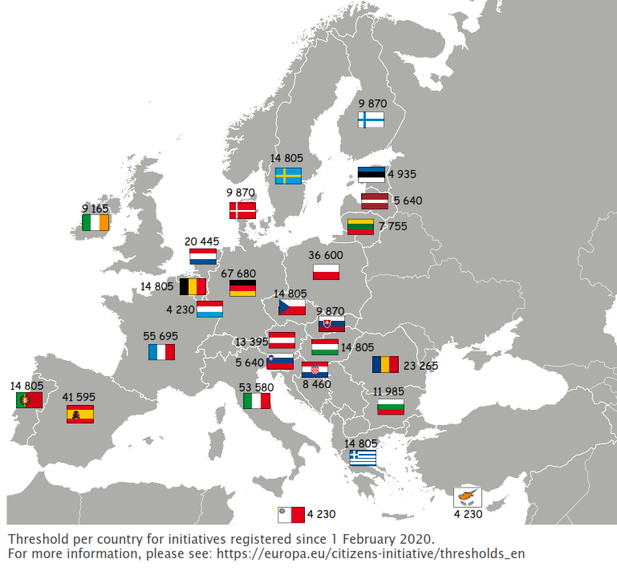
Collecting Signatures
The goal is to reach at least 1 million signatures,
including a minimum number in at least seven Member States, in 12 months

Slide 8
Collecting signatures - Overview
Organisers have 6 months from the date of registration of your initiative to decide when to begin the one-year collection of statements of support.
Organisers need to inform the Commission of the chosen date at the latest 10 working days before that.
Signatories need to be EU citizens (nationals of EU Member States) and old enough to vote in European Parliament elections (age 18 or lower in some Member States) – unless the Member State has decided to lower the minimum age for initiative signatories to 16 and has informed the Commission accordingly.
  See the list of age requirements.

Slide 9
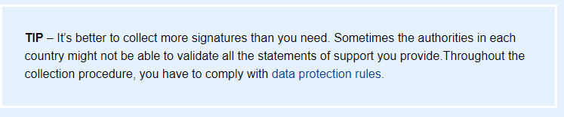
Collecting signatures - Overview
All EU citizens can sign an initiative regardless of their place of residence.
Citizens can sign only once for an initiative.

Slide 10
Collecting Signatures Online
As of 2023 the only system organisers of new initiatives can use to collect signatures for their initiatives online is the Central Online Collection System.
The Central Online Collection System is the tool provided by the European Commission to European citizens’ initiative organisers to collect statements of support online.

Slide 11
Jérôme Stefanini
IT Project Officer responsible for the Central Online Collection System
What is the Central Online Collection System?
What are the ways in which organisers can customise the central online collection system?
How can organisers access the statistics for signature collection?
What are the most important features of the central online collection system?
What are some tips you would give to current and future organisers using the central online collection system?

Slide 12
Nils Kluger
European Citizens’ Initiative Organiser,
Successful Stop Finning – Stop the trade initiative
What was your experience using the central online collection system?
What features of the central online collection system did you like most?
Which features were hard for you to find/manage?
What are some tips you would give to current and future organisers using the central online collection system?

Slide 13
For more information
Guidance notes
The Central Online Collection System
Procedural steps the successive phases of an initiative
How to look for partners practical tips and hints
How to draft an initiative legal requirements and practical advice
How to campaign common sense advice on promoting your initiative
How to collect signatures is often the hardest step
How to raise funds for your campaign
Success stories – Currently Available on the Forum
One of us pro-life initiative with papal backing
Right2Water the impact of prime-time TV coverage
Stop Glyphosate building on an existing pan-European campaigning network
Stop Vivisection the power of large groups of volunteers
End the Cage Age achieving its goal together with committed partners
Minority SafePack one million signatures for diversity in Europe
Useful links
Other Webinars
European Citizens' Initiative Forum Learn Page
European Citizens’ Initiative Website
Subscribe to the Newsletter

Slide 14
Thank you very much for joining us today!

